Slide 1

InternPath: Internship Aggregator
By Ishita Nakhawa
Roll No.: 150096725213
BTech-CSE2025-29

Slide 2
Index
Problem Statement
Solution
Working (Method/Mind map)
Conclusion.

Slide 3
PROBLEM STATEMENT
Students often struggle to find internships because the information is scattered across many different websites. Searching for opportunities takes a lot of time, and it becomes difficult to find internships that match a student’s university major or preferred location. Many students also want to know whether an internship is remote or on-site and how long it will last. Because of this, there is a need for a simple platform where students can easily search and filter internships based on their preferences. The goal of this project is to create a system that helps students quickly discover internships that suit their interests, location, and duration.

Slide 4
Solution
InternPath
│
├── images/
│
├── index.html → Homepage of the website
│
├── jobs.html → Displays all internship listings
│
├── filters.html → Allows students to apply filters
│
├── company.html → Allows to post internships
├── script.js → Handles JavaScript functions
│ (filters, search, sorting)
└── style.css → Provides styling and layout for pages
To solve this problem, we created a simple internship listing platform called InternPath. This website gathers internship information in one place and allows students to explore different opportunities easily. The platform shows internship listings, company details, and important information like duration and location. Students can also identify remote internships through special tags. The project was developed using HTML to create the structure of the web pages, CSS to design and style the interface, and JavaScript to add interactive features such as filters and search options.

Slide 5
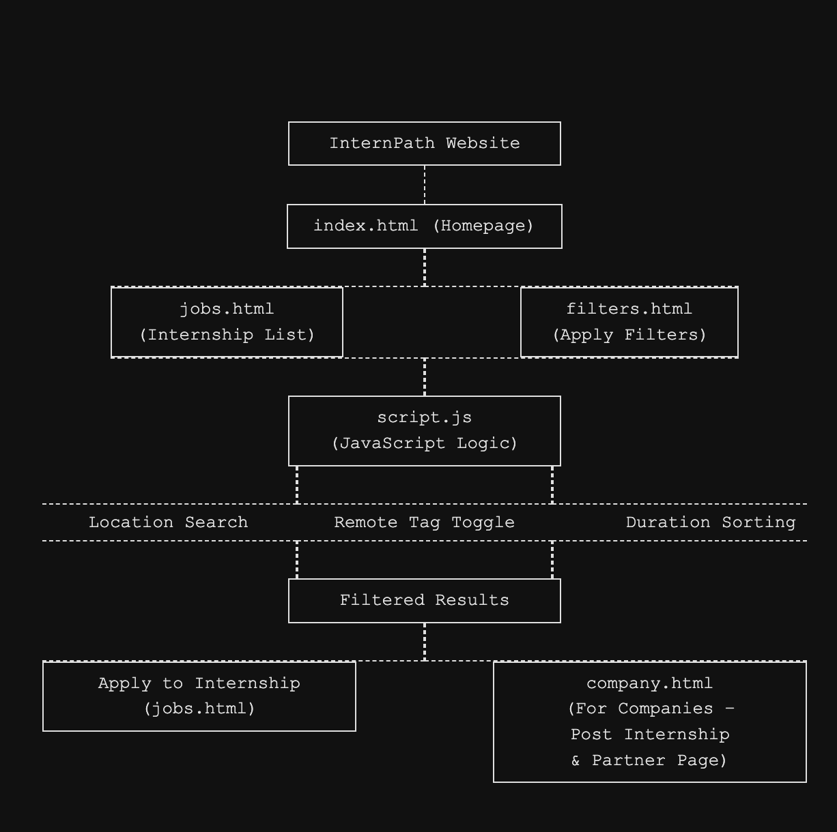
Working of InternPath:
The working of InternPath starts when companies post internship opportunities on the platform with details such as role, location, duration, and remote availability. These internships are then displayed on the Jobs page of the website. Students visit the homepage and browse the available internship listings. If they want specific results, they can use the filters to select preferences like location, remote internships, or duration. The JavaScript processes these selected filters and shows only the internships that match the student’s requirements. After finding a suitable internship, the student can open the company details page to view more information about the company and the internship role.

Slide 6
Conclusion
InternPath provides a simple and organized way for students to search for internships. Instead of visiting multiple websites, students can use one platform to explore opportunities and filter them based on their needs. The project demonstrates how basic web technologies like HTML, CSS, and JavaScript can be combined to build a useful web application. In the future, the platform could be improved by adding features such as user login, company accounts for posting internships, and connections to real internship databases to make the system even more useful.

Slide 7
Thank you

